Slide 1
A Major Project Presentation on
AyurMarg : Personalized Ayurvedic AI Health Assistant in The Fulfillment of Final Year Computer Engineering – Major Project
(A. Y. 2024-25) Department of Computer Engineering (Regional Language) PCET’s Pimpri Chinchwad College of Engineering

Slide 2

AyurMarg: AI-Powered Personalized Ayurvedic Health
Team Members
Atharva Ingle : 121B1D026
Prathamesh Wakde : 121B1D027
Raman Thatte : 121B1D048
Gauri Nimje : 121B1D063
Guided By Prof. Ganesh Deshmukh

Slide 3
Contents
Introduction
Motivation
Objectives
Literature Survey
Dataset
Dataset Design
System Architecture
Class Diagram
Project Requirements
Proposed System
Complexity of Project
Project Timeline
Software Testing
Contribution to Sustainable Development Goals
Results
Future Scope
Conclusion
Details of Patent Filing
References

Slide 4
Project Introduction
Ayurveda is a 5000+ year-old system of holistic medicine emphasizing the harmony of body, mind, and soul.
Personalized healing based on Prakriti (individual constitution) and Doshas (Vata, Pitta, Kapha).
Traditional knowledge is buried in Sanskrit texts like Charak Samhita & is not accessible to all.
Rising demand for personalized, preventive healthcare in the digital age.
AyurMarg bridges this gap by combining Ayurvedic wisdom with AI-powered technology for real-time, personalized health guidance.

Slide 5

Problem Definition
Complex Ancient Knowledge
Lack of Personalized Tools
Ayurvedic texts are hard to access and interpret.
Few platforms offer deep Ayurvedic personalization.
Missing AI Integration
No accurate AI-enabled Ayurvedic consultancy available.

Slide 6
Motivation, Need & Scope
Increasing global interest in natural, holistic, and personalized healthcare.
Potential of AI and NLP to interpret ancient Sanskrit texts and deliver insights in real-time.
Need to democratize Ayurveda for the modern world, especially youth, through technology.
Scope includes:
Digitizing and structuring classical Ayurvedic knowledge.
Personalized health assessment based on Doshas.
Providing actionable diet, lifestyle, and therapy recommendations.

Slide 7

Project Objectives
AI-based Health Consultation
Simulate personalized Ayurvedic health sessions digitally.
Classical Text Integration
Extract and embed knowledge from key Ayurvedic texts.
Dynamic Dosha Analysis
Use AI-driven questioning for personalized evaluation.
Personalized Prescriptions
Generate tailored diet, lifestyle, and therapy advice.
Accessible & Accurate Guidance
Ensure empathy and trust in digital health recommendations.

Slide 8
Literature Survey
Sr. No. | Title | Year | Methodology | Strengths | Weaknesses
1 | Ayurvedic Health Prediction Models | 2021 | Machine learning models to predict health conditions based on Ayurvedic principles. | - Uses AI to analyze Ayurvedic data. - Provides predictive health insights. | - Limited dataset of Ayurvedic data. - Relies on generic AI models without deep integration of Ayurveda.
2 | Integrating AI with Traditional Medicine | 2020 | AI-driven integration of modern medicine and Ayurveda. | - Supports a holistic approach to healthcare. - Combines modern AI with traditional knowledge. | - Needs further validation with real Ayurvedic practitioners.
3 | Dosha Analysis using AI | 2022 | AI model to analyze Dosha imbalances from user data. | - Direct application of AI for Ayurvedic diagnosis. - Accurate Dosha predictions. | - Limited scope for lifestyle and environmental factors.
4 | Personalized Healthcare via AI | 2019 | Personalized AI-driven healthcare recommendations. | - Tailors recommendations to individual needs. - Scalable across various health domains. | - Focuses on general healthcare, not specifically Ayurvedic.
5 | AI-powered Health Assistants in Ayurveda | 2021 | AI chatbot to provide Ayurvedic consultations. | - Direct interaction with users. - Personalized Ayurvedic consultation. | - May lack the depth of Ayurvedic knowledge in some cases.
6 | Modernizing Ayurveda with AI and Big Data | 2020 | Big Data analysis and AI for Ayurvedic practices. | - Incorporates large datasets. - Potential to scale Ayurvedic practices globally. | - Lack of focus on real-time applications and patient engagement.

Slide 9
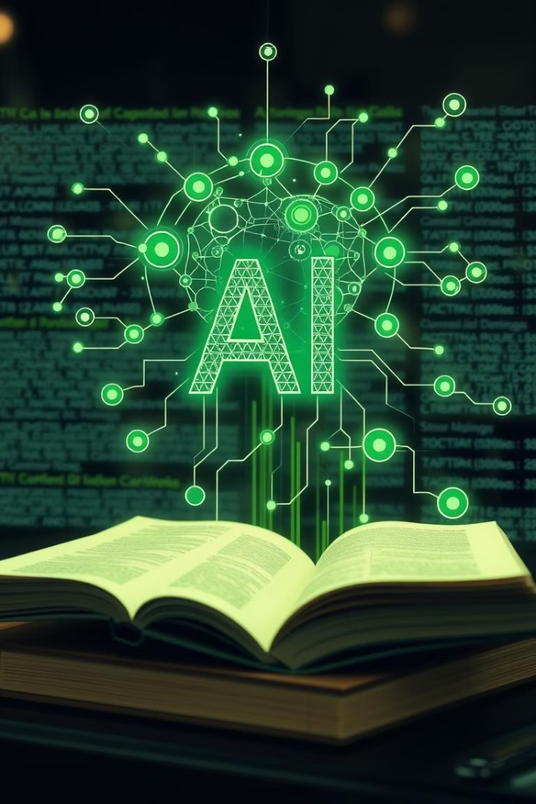
Dataset & Dataflow
Text Preprocessing
Sanskrit and English translation
Tokenization, chunking, and cleaning of Ayurvedic scriptures
Embedding Generation
Using all-MiniLM-L6-v2 from Sentence-Transformers
Converts texts into high-quality vector embeddings
RAG Pipeline
Combines user input with top FAISS-retrieved chunks
Delivers accurate, context-rich AI responses
Datasets Used
Curated texts from Charak Samhita
Annotated Dosha questionnaires
Symptom-Dosha mappings (manually validated)

Slide 10
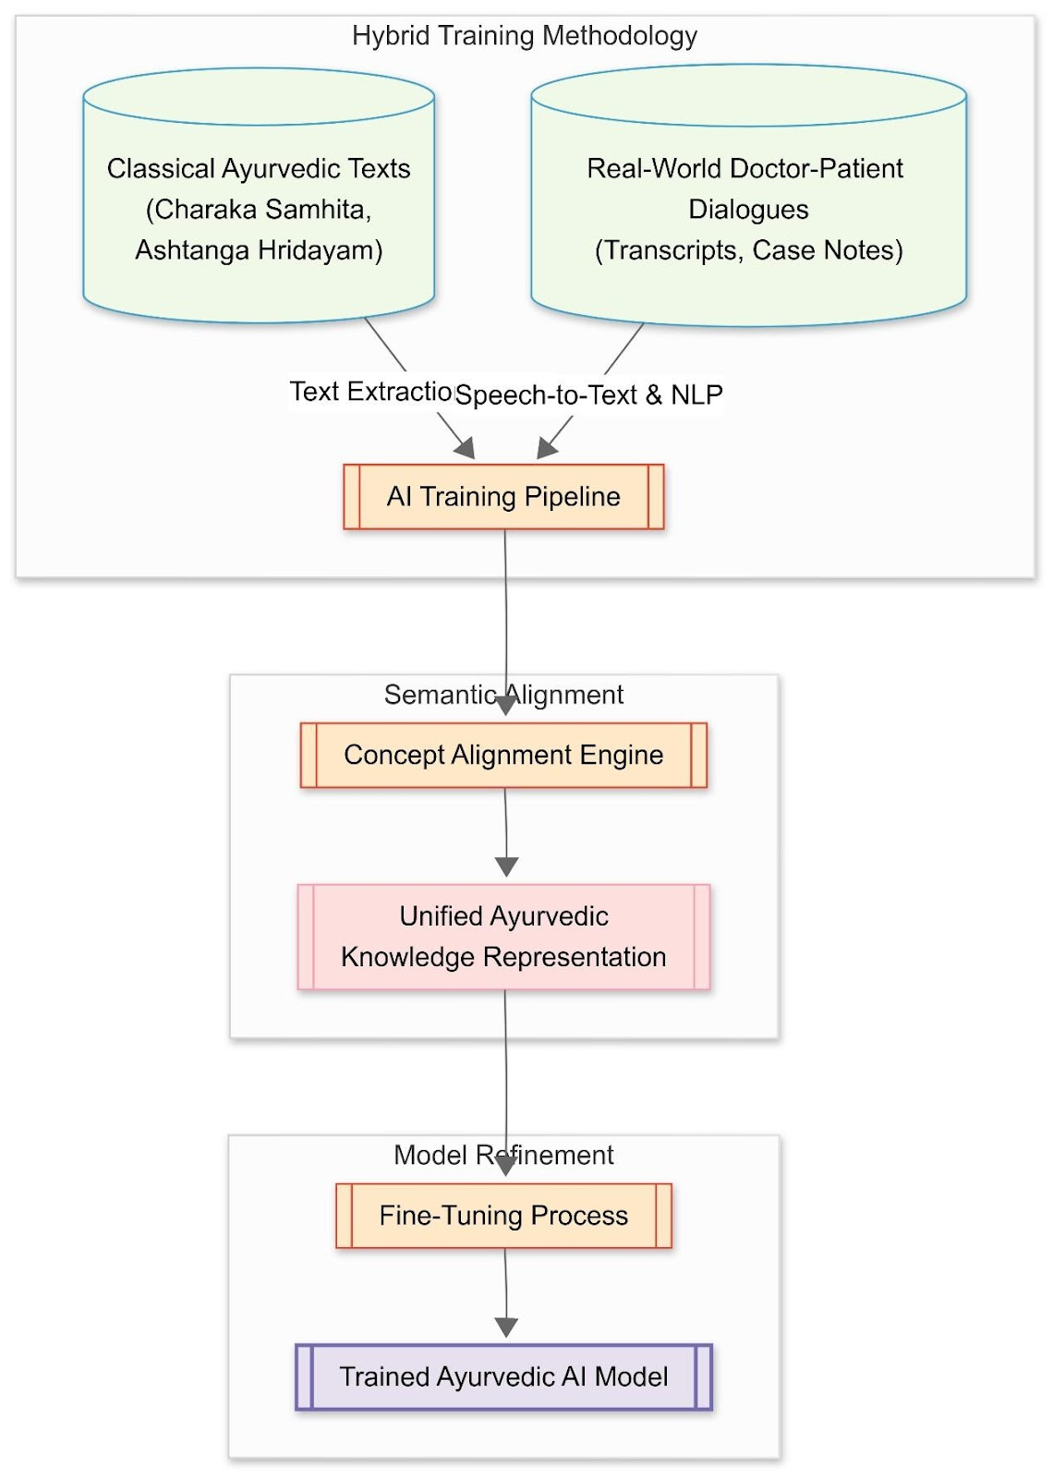
Dataset Design

Slide 11
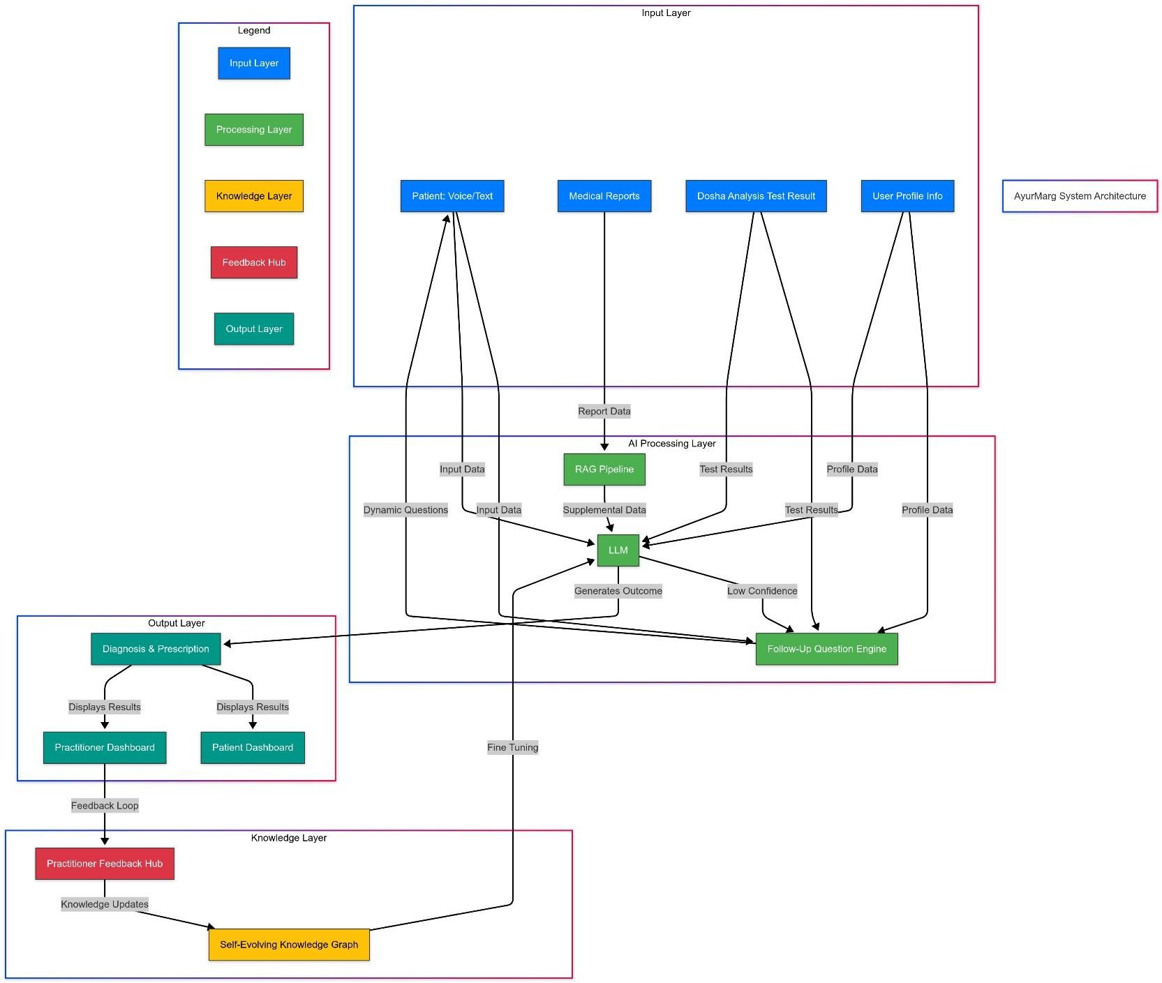
System Architecture

Slide 12
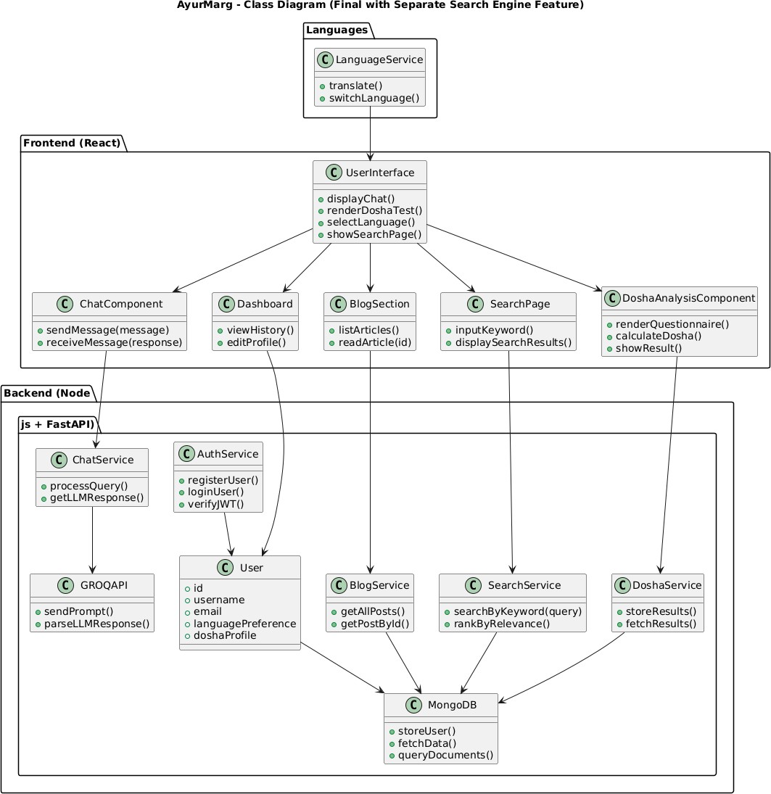
Class Diagram

Slide 13
🛠️ Software Requirements Specification
Frontend
Backend
Database
Vite + ReactJS
Node.js, Express.js
MongoDB (User Data, Test Results)
Tailwind CSS
FastAPI for AI API
GSAP & Locomotive for animation
AI & NLP Stack
Tools
Grok (Model Agnostic), Sentence-Transformers
VS Code, GitHub, Postman, Gamma, PyTorch
LangChain, GROQ API
FAISS (Vector Store)
RAG Architecture

Slide 14
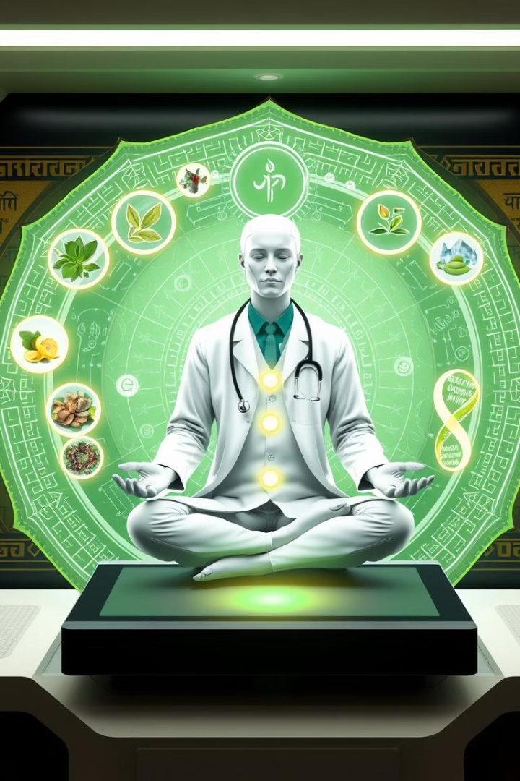
Proposed System
AyurMarg: Personalized Ayurvedic AI Health Assistant
Web-based platform offering AI-driven Ayurvedic consultations.
Combines classical Ayurvedic wisdom with modern AI tools.
RAG architecture enables information retrieval from ancient scriptures.
Performs Dosha analysis, symptom interpretation, and treatment recommendation.
Adaptive questioning mechanism simulates real doctor-patient interaction.
Provides complete Ayurvedic prescriptions based on Prakriti, Vikriti, Agni, climate, and lifestyle.

Slide 15
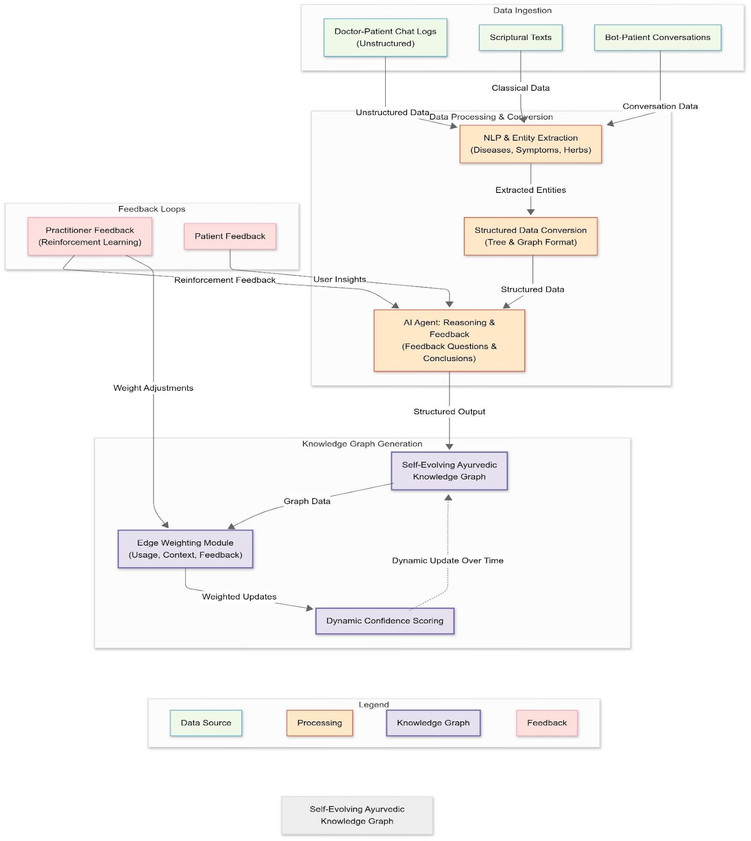

Slide 16
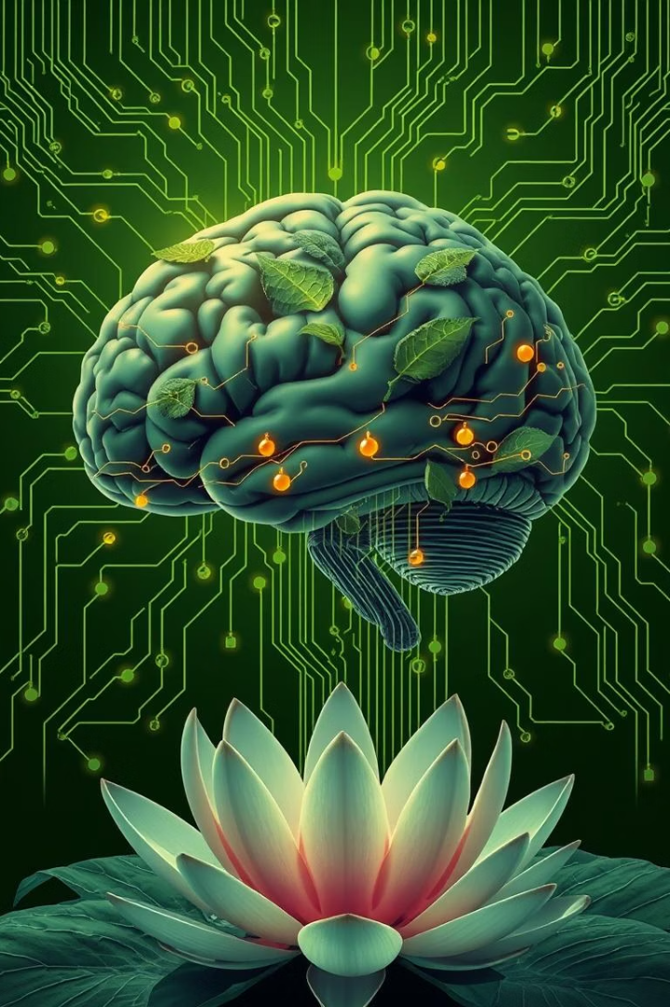
Complexity of Project
Multi-stack architecture: MERN + Python-based AI backend.
Integration of classical texts into modern vectorized formats.
Ensures semantic search accuracy via FAISS and transformers.
Developed RAG + LangChain agent using GROQ for low-latency inference.
Dynamic front-end animations using GSAP and LocomotiveJS.
Requires cross-disciplinary knowledge (Ayurveda + AI + Web Dev).

Slide 17
📅 Project Timeline
Month 1-2
Month 5
Research on Ayurvedic texts and Dosha analysis
RAG model implementation
Functional Dosha test and retrieval working
Finalization of tech stack
1
2
3
4
Month 3-4
Month 6
Data cleaning, chunking, and vector database setup
UI completion and testing
Demo version launched
Frontend and API integration started

Slide 18
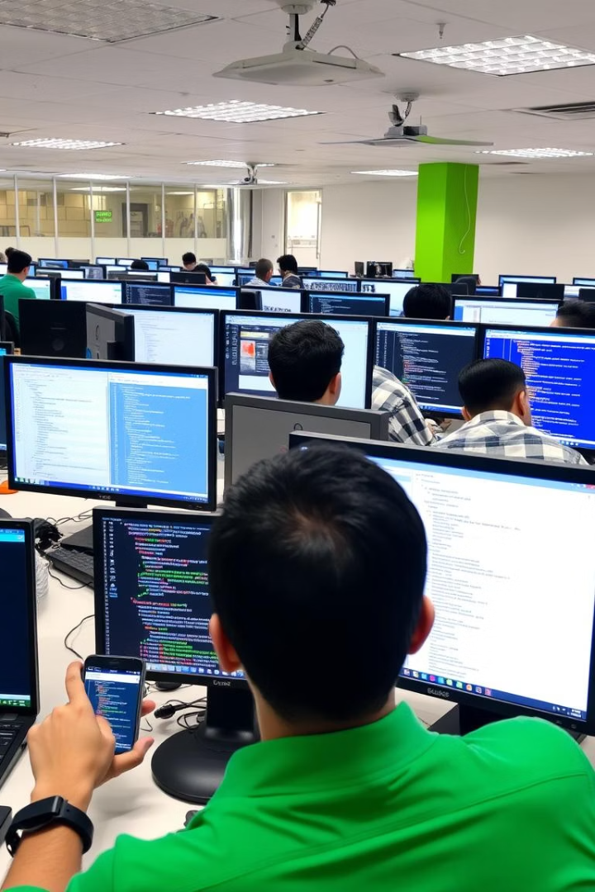
Software Testing
Unit Testing
Each module (Dosha analyzer, chatbot, search engine) tested individually.
Integration Testing
Ensured smooth interaction between frontend, backend, and AI model.
User Acceptance Testing (UAT)
Tested with real users for flow, accuracy, and experience.
Validation by Ayurvedic Practitioners (Planned)
In beta phase, expert feedback will be used to validate prescriptions.

Slide 19
Contribution to Sustainable Development Goals (SDGs)
Mapping to SDGs
SDG 3: Good Health and Well-Being
Promotes preventive and personalized healthcare using Ayurveda.
SDG 4: Quality Education
Educates users on holistic wellness based on authentic scriptures.
SDG 9: Industry, Innovation, and Infrastructure
Integrates AI with ancient medical systems for scalable solutions.
SDG 11: Sustainable Cities and Communities
Encourages natural and sustainable living practices.

Slide 20
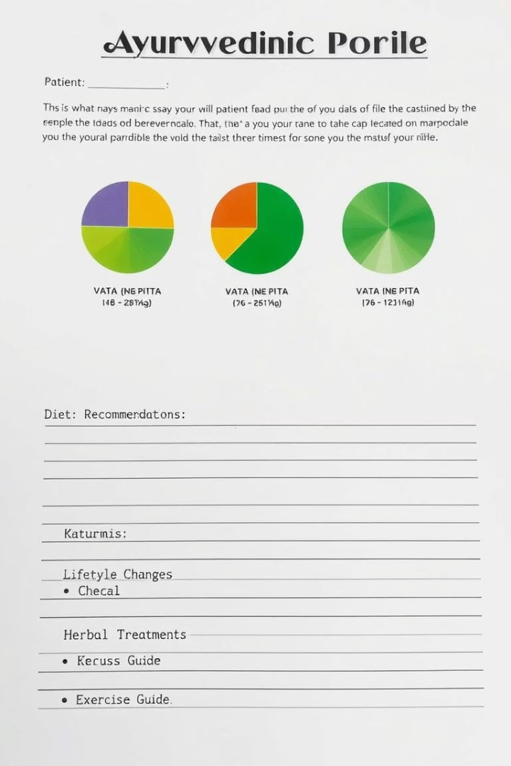
Results
Functional MVP developed with core modules:
Dosha Test, Ayurvedic Search, and AyurBot.
AyurBot provides personalized prescriptions based on Ayurvedic principles.
Successfully retrieves information from Charak Samhita using RAG.
Tech Stack Proven: MERN, LangChain, GROQ API, and FAISS.
User Interface designed to be interactive, intuitive, and responsive.

Slide 21
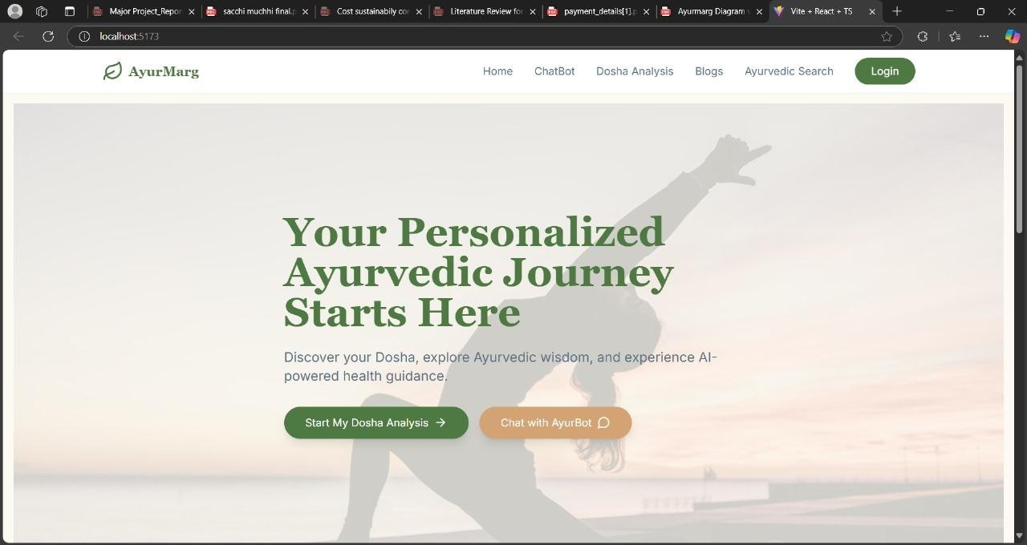
Results

Slide 22
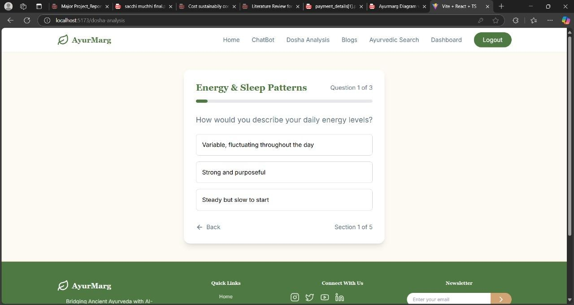
Results

Slide 23
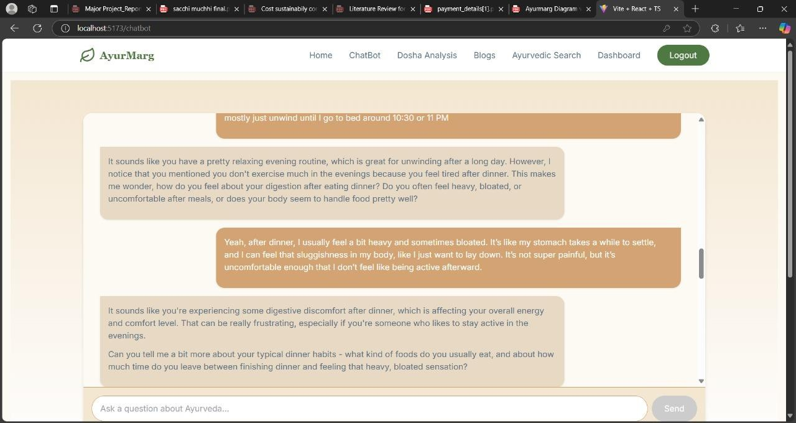
Results

Slide 24
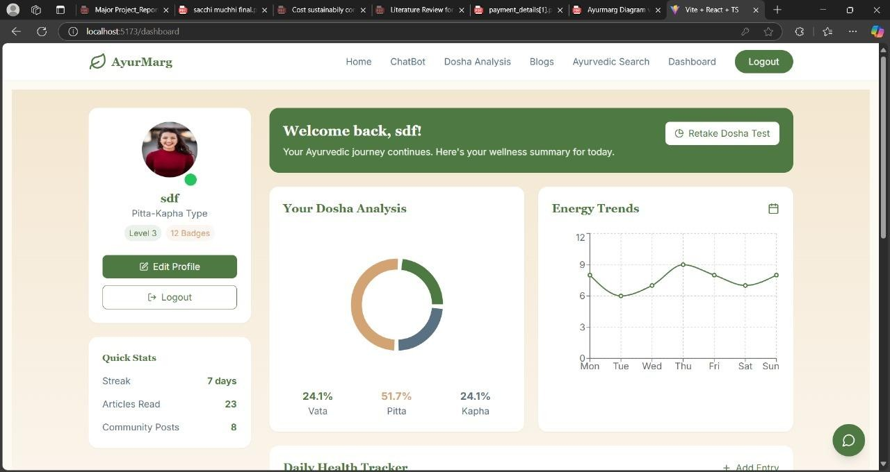
Results

Slide 25
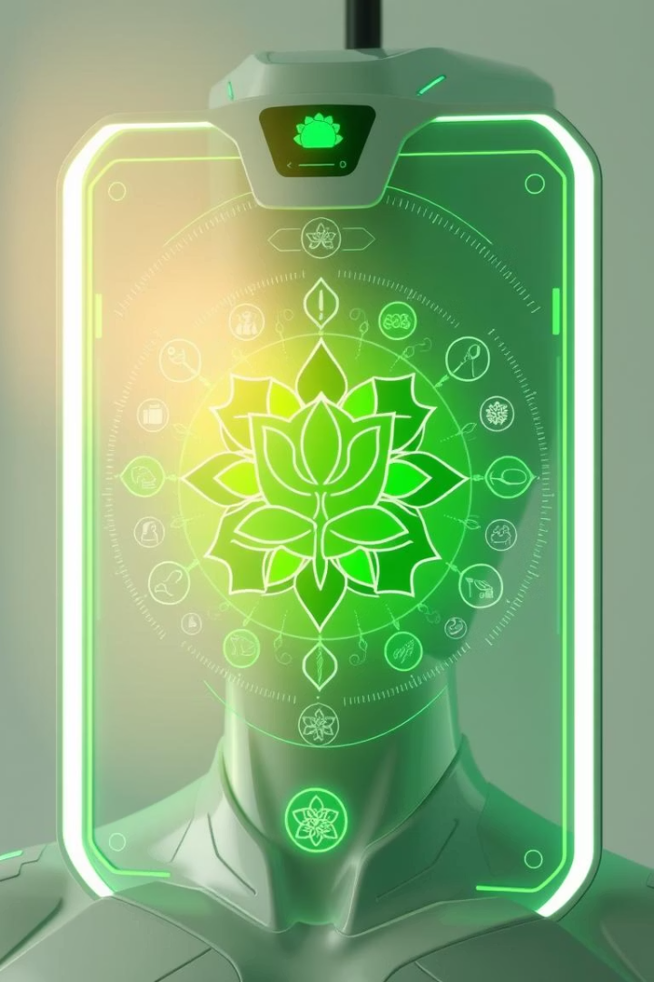
Future Scope
Exploring innovative developments to expand AyurMarg's impact and accessibility.
Mobile App Development for enhanced accessibility and daily health tracking.
Integration with wearable devices for real-time Dosha imbalance detection.
Expanding knowledge base with more Ayurvedic texts and multilingual support.
Collaborations with Ayurvedic practitioners for real-time consultations and validation.
Incorporating voice-based interaction and emotion analysis for deeper personalization.

Slide 26
Conclusion
The system offers personalized health guidance based on Dosha analysis, backed by classical texts such as the Charak Samhita.
AyurMarg successfully bridges the gap between ancient Ayurvedic wisdom and modern AI technologies like RAG, Lang Chain, and the GROQ API.
It enhances accessibility, supports preventive healthcare, and promotes holistic wellness through digital innovation.
Our project demonstrates the potential of integrating traditional sciences with AI, paving the way for intelligent, culturally rooted health assistants.

Slide 27
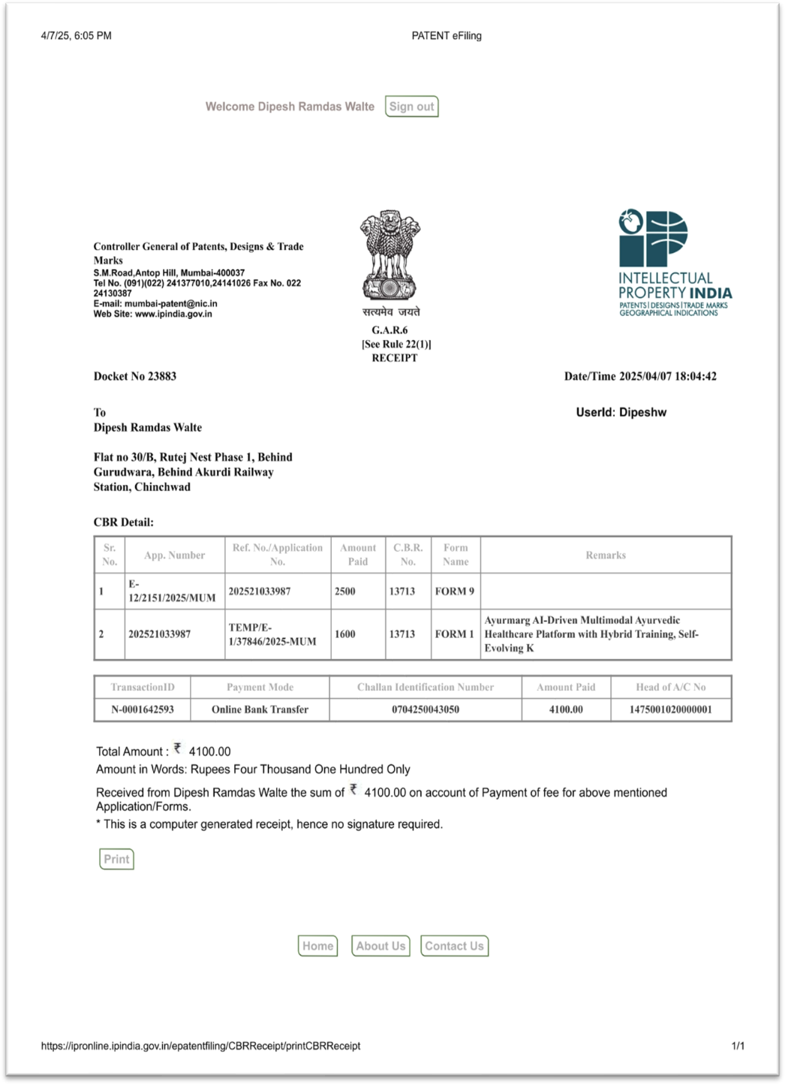
Details of Patent Filing

Slide 28
References
[1] S. K. Sharma, A. R. Singh, and R. Gupta, "Ayurvedic Health Prediction Models," Journal of Ayurvedic Medicine and AI, vol. 12, no. 4, pp. 234-241, 2021.
[2] P. S. Verma and D. K. Nair, "Integrating AI with Traditional Medicine," in Proceedings of the International Conference on Health Tech Integration, New York, USA, 2020, pp. 75-80.
[3] M. Sharma, S. S. Mehta, and A. G. Joshi, "Dosha Analysis Using AI," Ayurvedic Health and Technology Journal, vol. 9, no. 3, pp. 119-127, 2022.
[4] T. R. Jadhav and K. P. Desai, "Personalized Healthcare via AI," International Journal of Personalized Medicine, vol. 11, no. 1, pp. 56-62, 2019.
[5] V. Patel, S. K. Sharma, and R. B. Patel, "AI-powered Health Assistants in Ayurveda," Journal of Health Tech & Innovation, vol. 15, no. 6, pp. 201-207, 2021.
[6] N. P. Mehta and R. S. Reddy, "Modernizing Ayurveda with AI and Big Data," Computational Medicine Journal, vol. 8, no. 2, pp. 88-94, 2020.

Slide 29
Thank You !!

